Slide 1


MULTI-DIMENSIONAL RAYCASTING
Batch no: 10
Done by,
Shadrach Gideon S P - 311419104071
K Suraj - 311419104083
SK Wasi Ahamed - 311419104097
Zaffer Ahmed H M - 311419104100
Guided by,
Ms.D.Rejitha, M.E.,
CSE DEPARTMENT

Slide 2
OUTLINE
Introduction
Objective
Motivation
Literature Survey
Existing System
Purposed System
System Requirements
Modules
Conclusion
References

Slide 3
INTRODUCTION
Raycasting is a game engine concept, which is used to project 2D plane into 3D view.

Slide 4
OBJECTIVE
The main objective of this project is to develop a 3D Shooter Game with A.I. enemies using Pygame package in python.

Slide 5
MOTIVATION
Raycasting is the basic concept which is used in many game engines.
Compared to the previous builds, we have optimized it quite a lot.

Slide 6
LITERATURE SURVEY
S.NO. | TITLE | TECHINIQUE/ALGORITHM | ADVANTAGES | DISADVANTAGES
1. | “Multi-dimensional Raycasting for Fuzzy Pattern Classification”. ARIS Lanaridis and Andreas Stafylopaths, 2009 | Raycasting | Easy to implement. | Slow compared to other methods. Many Artifacts.
2. | “Development of Programming Materials Using Gameplay RPA”. Hiroshi Yokoyama and Takahiro Matsumoto, 2020 | Robotic Process Automation, A.I. | It can choose between variety of actions presented. | Predictable.
3. | “Pixel Python RPG: Repurposing an Entertainment Game to an Open Educational Resource for Computer Programming Fundamentals”. Josivan Pereira da Silva, 2021 | Python, Pygame | It's genuinely easy to utilize and run on any environment. | Managing SDL surfaces wasn't a lot of fun. It only handles 2D textures.
4. | “Evaluation of Individualized HRTFs in a 3D Shooter Game”. Jonas Siim Andersen and Riccardo Miccini, 2021 | HRTF (Head Related Transfer Functions) | Better hearing in- game. | Sometimes there is loss of quality
5. | "A Survey of Frameworks and Game Engines for Serious Game Development“. Brent Cowan and Bill Kapralos. 2014 | Python, Pygame, C++, Java Script | Great toolkits to develop games in | Some require royalties to be paid.

Slide 7
EXISTING SYSTEM
The Doom concept was proposed in the late 1992 after the release of Wolfenstein 3D.
This concept was used to improve 3D game engines, and used the improved design for future games.
Doom was programmed largely in the ANSI C language, with few elements in Assembly language on NeXTSTEP operating system.
DISADVANTAGES
This kind of game engine was developed in the late 90s, thus proving it’s not upto trend.
Pixel graphics in the old games are choppy and low quality.
Many glitches and bugs are discoverable in these old games.

Slide 8

EXISTING ARCHITECTURE DIAGRAM
User
Asset Manager
Inputs
ANSI C and Assembly Script
Interface
Audio
Outputs
A.I. Script
3D Map
Ray casting
2D Map

Slide 9
PROPOSED SYSTEM
We have proposed an improved system which is based on the old game engines.
With the newly available software to manipulate images and improved coding languages we can confidently say that this system beats the old one.
ADVANTAGES
Numerous amount of software for image manipulation is available for creating 4K high resolution pixel images.
With the package available in the coding language python, we are able to create the game without any bugs. If any is found, the bug fixes are easy than older times.
By recreating the game engine of the old times, we can improve it into a better version with the newly available coding software.

Slide 10
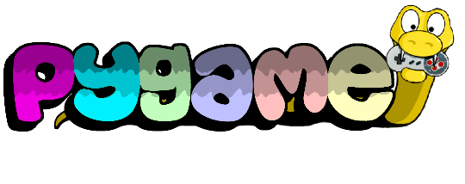
ARCHITECTURE DIAGRAM
User
Asset Manager
Inputs
Interface
Audio
Outputs
A.I. Script
3D Map
Ray casting
2D Map

Slide 11
SYSTEM REQUIREMENTS
Hardware Requirements
System : Pentium IV 2.4 GHz.
Hard Disk : 40 GB.
Monitor : 15 VGA Colour.
Ram : 2 GB.
Video card : GTX 910 or higher
Software Requirements
Operating system : Windows 10
Programming Language : Python 3.10.4
Tool : Sublime text

Slide 12
MODULES
Adding Input Management System.
Implementing Actions for Player (Shoot).
Designing Character and Other Entities using Photoshop.
Creating a Medium-Scale map.
Adding Sprites.
Building Ray-casting as a Game Engine.
Implementing Unique A.I. Enemies.
Placing Entities in unique places of the game map.

Slide 13
Adding Input Management System
The game character is controlled using the inputs from the Keyboard and Mouse.
When a key or a mouse movement occurs, the code detects it and executes a specific script according to the condition.
The movement of the player is done by using a few formulas shown in the next slide.
Gravity isn’t needed in this game, This is because the gameplay is set in a 2D plane.
Module 1

Slide 14
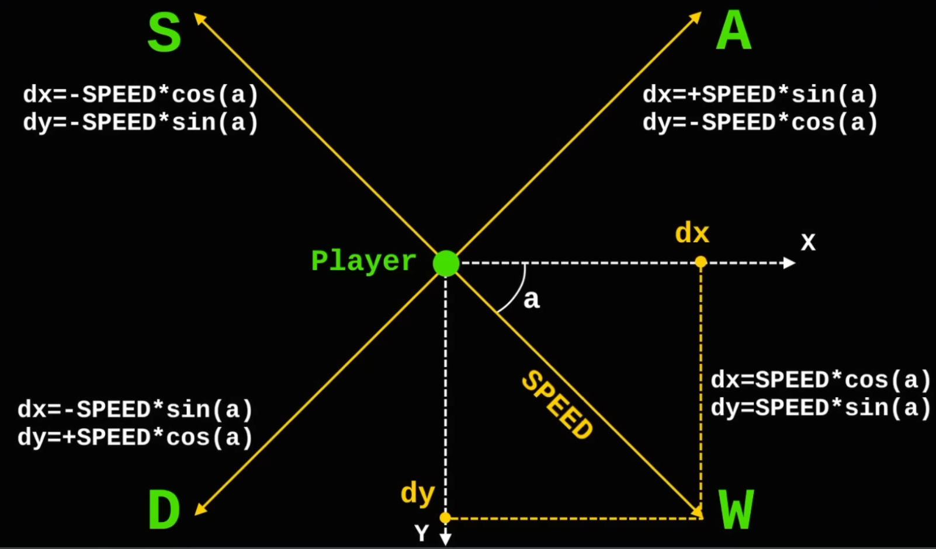
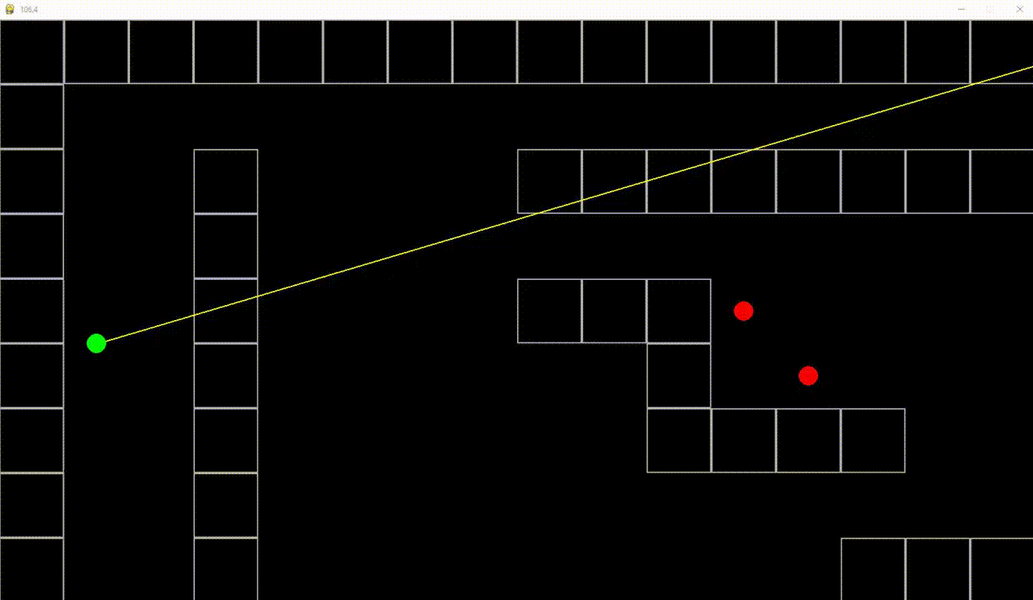
The formulas in the picture are for every axis, which when the assigned key is pressed the according formula is executed, which prompts the character to move in that specific direction.
The gif shows how the player moves in the map using the formulas in the code when the key is pressed.
Similarly when the mouse is moved the character’s vision is also moved accordingly.
Module 1

Slide 15
Implementing Actions for Player
The player will be able to perform the basic actions,
> Move
> Shoot (Damage given)
> Damage taken
> Regenerate health
Movement of the player is already implemented using the Input Manager.
We used the Input manager again to record a certain action from the user, left click.
When the action is performed, the script will update both the weapon sprite and the values in the game.
Module 2

Slide 16
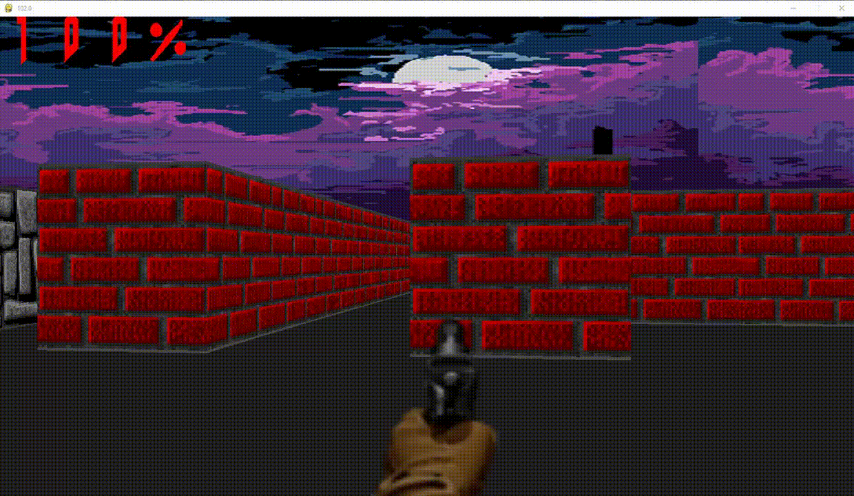
Damage given is more complex than shooting, the values of when the player presses the shoot button is defined as “shot_damage”. We’ll use the vision line, which the player has to look around as a way of shooting, the only way to change values for anything is when the line intersects with it. The updating of these values can be customized in the script.
Health regeneration works when the player is not taking damage for a set amount of time, then the script will allow the player to replenish their health.
Module 2

Slide 17
Designing Character and Other Entities using Photoshop
We use Photoshop to create textures for the game map and entities.
We can also use other software to create these said textures.
The Resolution for the images is 64x64 pixels and has a transparent background.
The textures created for the player and NPC (enemy) are called as sprites.
These sprites are inserted into a looping statement of the code.
This looping statement will make the images look alive, thus giving a lively feel to the game.
Some static sprites can be used for environment decorations.
Module 3

Slide 18
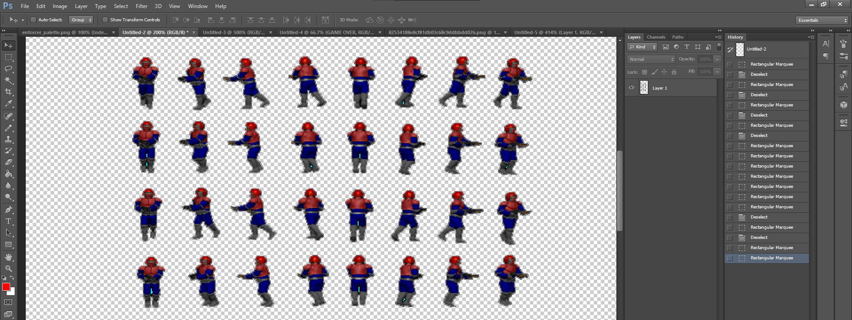
Sprites being designed in Photoshop
Module 3

Slide 19
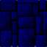
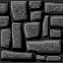
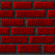
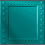
Creating a Medium-Scale map
The mini map is made using list.
This list acts like a matrix which is used to put walls in the game.
The matrix values are as integers (1, 2, 3, etc..), these integers correspond to each texture which we have defined in the Object renderer module.
Module 4

Slide 20
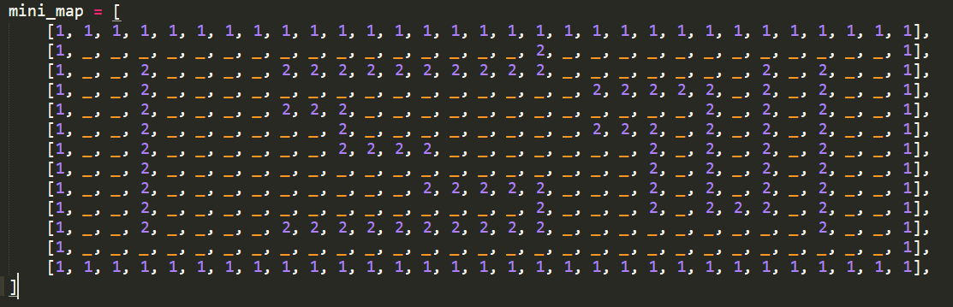
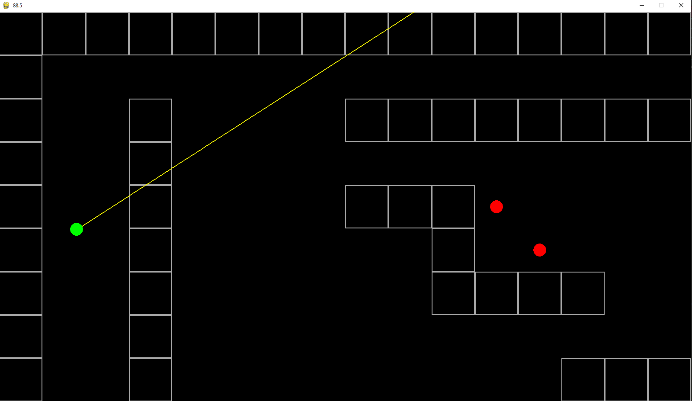
This is the how the matrix is defined in the script, map.py
The length of the map can be infinite.
This is the view of the game in a 2D plane
This 2D plane shows how the integers in the matrix play a significant role in map creation.
Module 4

Slide 21
Adding Sprites
The textures we designed earlier is used here.
Different types of sprites are used to give life and variety to the game.
There are about 2 types of sprites,
> Static Sprite
> Dynamic Sprite
To add a static sprite on the map we just need to add the position of where that specific item/object or entity or a weapon for the player.
To add a animated sprite on the map, we use the same concept as the static sprite but addition looping statement is required to make the sprite look animated.
Module 5

Slide 22
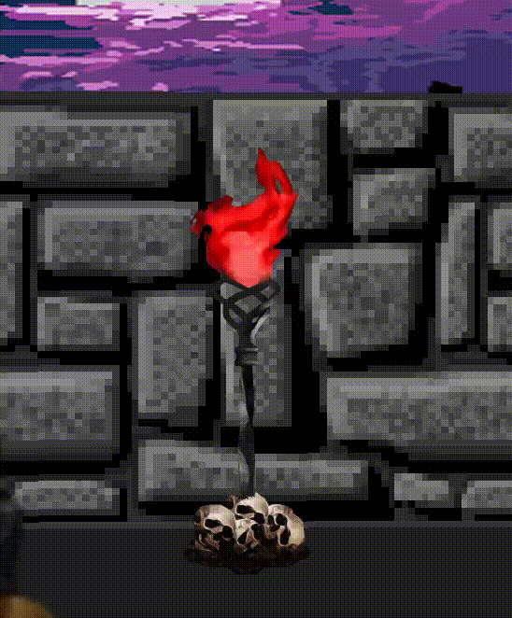
The gif presented on the right, is an animated sprite which is implemented in the map.
We can add as many animated sprites as we can, each sprite needs to be of a different name to be added into the playable map.
Module 5

Slide 23
Building Ray casting as Game Engine
The Ray casting concept is used to project a 2D plane into a 3D perspective.
Using this concept, we build a game engine with the ability to manipulate anything in the game to make it look and feel lively.
Ray casting is also called as Pseudo 3D.
This concept is mainly used in old games which age back to the 90s.
Ray casting allows for games to be optimized in such a way that even the low-end computers can handle.
Module 6

Slide 24
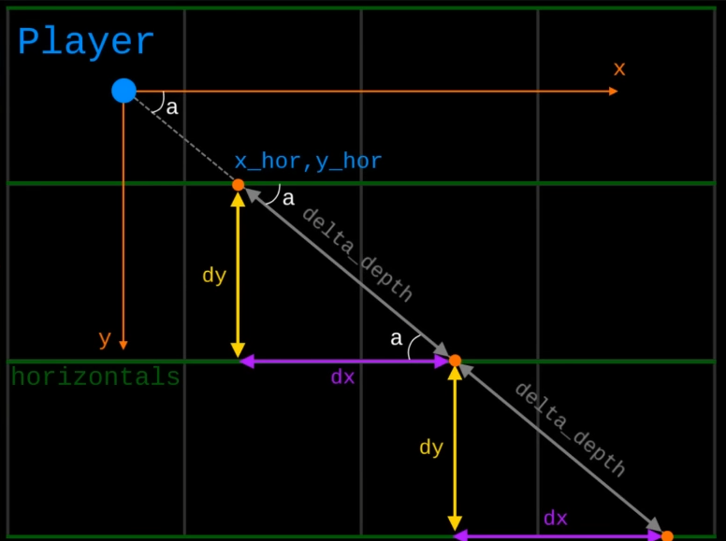
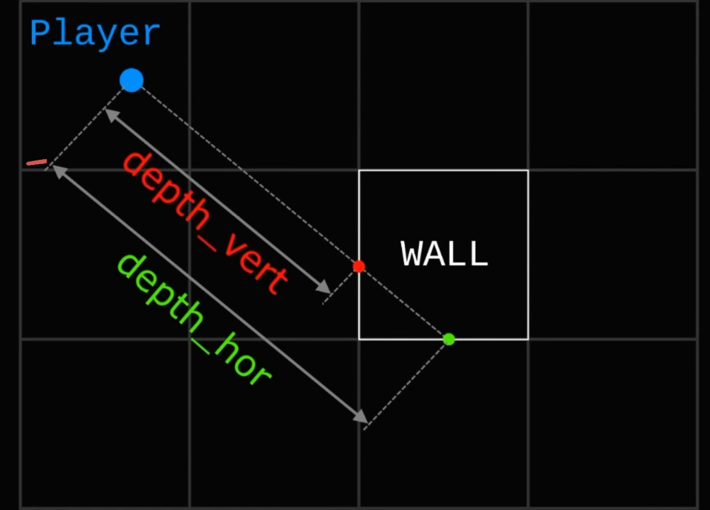
Working of Ray casting is based on Trigonometry formulas.
These ray will have a point of intersection between each vertices.
These vertices are the different matrix values assigned on the map to act as a wall or floor.
Each and every straight line which corresponds to the vertical and horizontal vertices are measured using depth.
Module 6

Slide 25
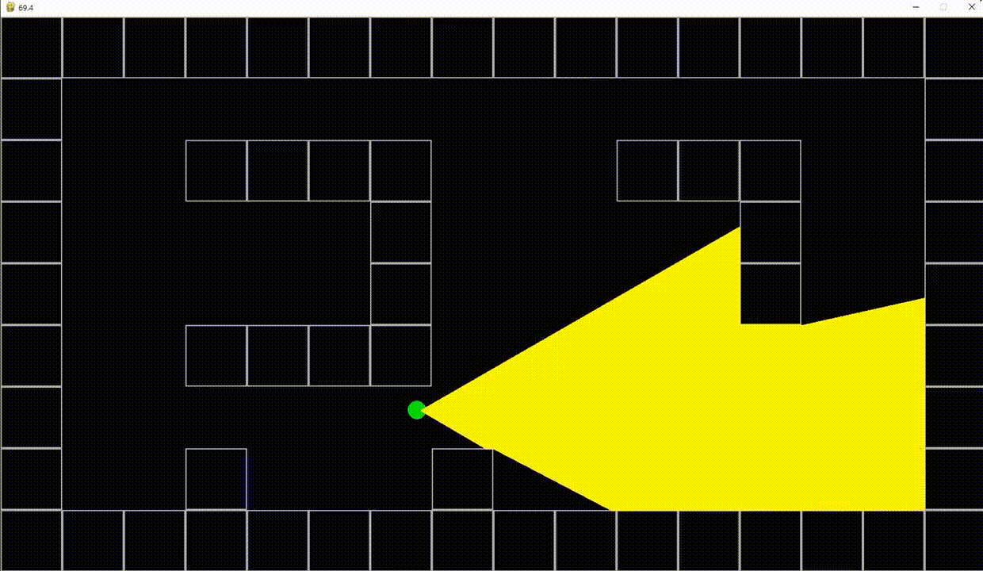
As from the above images, the yellow ray coming from the green point (player) is a combination of multiple rays interacting with the world. This interaction is purely used for the next step in Ray casting which is 3D projection.
In 3D projection we use the rays to cast a 3D projection on the screen, thus the name Ray casting.
When the rays hit a certain object on the map it creates a point, we use that point to project a 3D projection of the game using texture and that point of contact.
> More rays = Better 3D projection <
Module 6

Slide 26
Implementing Unique A.I. Enemies
We add in enemies to make the game more challenging.
A separate script is written for A.I. enemies, this script is activated once the A.I has visual of the player in its line of sight.
The sprite is also updated this way to make the enemy look animated.
Once the player is in A.I. visual, the A.I will proceed to seek out the player, in addition the A.I. also damages the player at a certain distance, Thus resulting in a getting damaged feel.
The damage given/taken by the A.I is customizable in the script.
Module 7

Slide 27
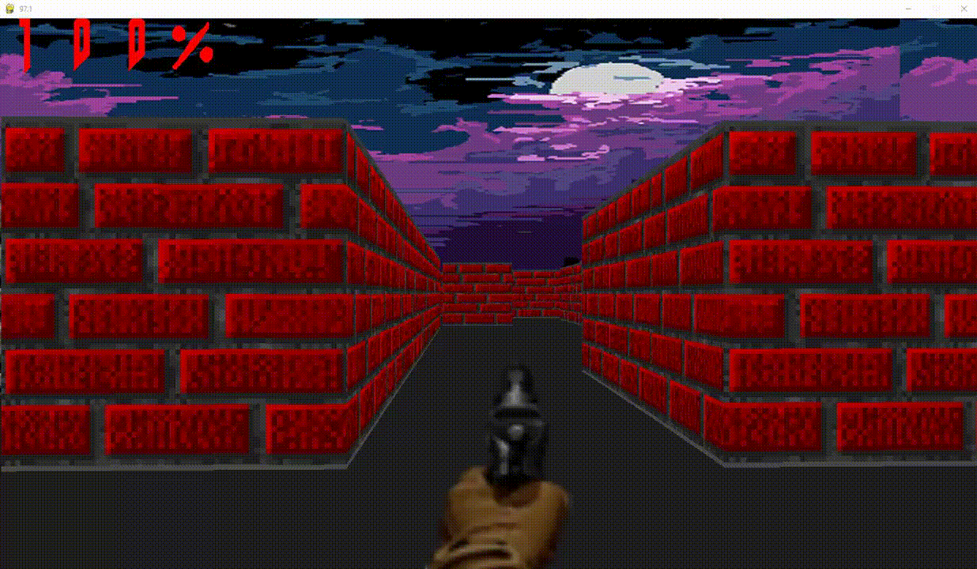
As seen in the gif the A.I. enemies move towards the player, when they are in front of the A.I.s Visual.
When the A.I. takes damage from the player the sprite is also updated, and once it’s health value reaches 0, the sprite is updated to a static death sprite.
The damage taken by the player is also viewed on the top left corner of the screen, it is called a HUD.
Module 7

Slide 28
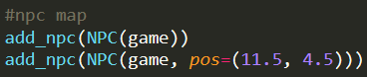
Placing Entities in unique places of the game map
In the script we can define the position of the entities and objects of the game.
Position is decided by giving x and y coordinates.
Module 8

Slide 29
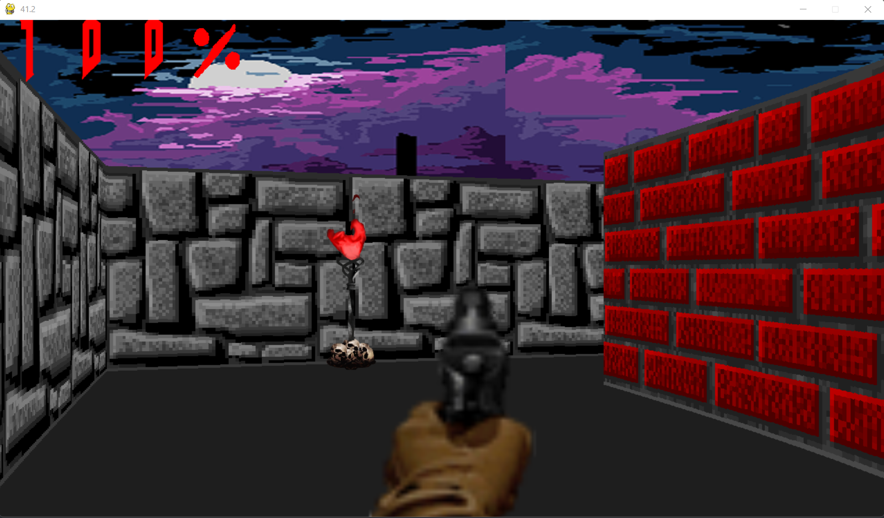
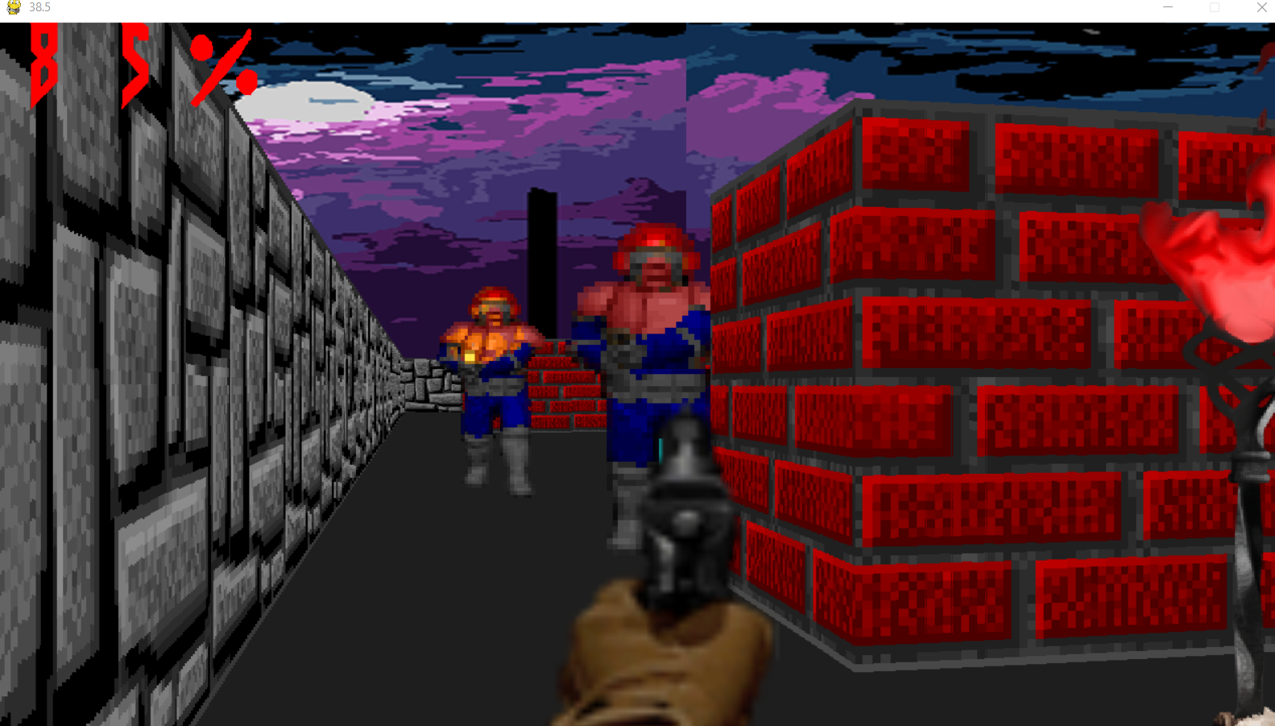
OUTPUT IMAGES

Slide 30
CONCLUSION
The purpose of our project is to develop a Improved Game Engine while also developing creativity and individuality in problem solving and overcoming great difficulty by properly analyzing situations within the game world.
FUTURE ENHANCEMENTS
Improving the quality of the textures.
Increasing the amount of Enemies, adding variety.
Improving the game’s UI and in-game HUD.

Slide 31
REFERENCES
[1] Brent Cowan and Bill Kapralos, "A Survey of Frameworks and Game Engines for Serious Game Development", 2014 IEEE 14th International Conference on Advanced Learning Technologies.
[2] Georgios N. Yannakakis and J. Togelius, Artificial Intelligence and Games, New York, NY, USA:Springer-Verlag, 2018.
[3] Jonas Siim Andersen and Riccardo Miccini, “Evaluation of Individualized HRTFs in a 3D Shooter Game”, Immersive and 3D Audio: from Architectrue to Automotive (I3DA), 2021
[4] Matthias Labschütz et al., "Content creation for a 3D game with Maya and Unity 3D", Institute of Computer Graphics and Algorithms Vienna University of Technology, 2011.
[5] Meng Yang and Zhen Wang, “Research on of 3D game design and development technology”, 3rd Internataional Conference on Computer Science and Information Technology, 2010.
[6] Pa. Megha, L. Nachammai and T.M. Senthil Ganesan, "3D Game Development Using Unity Game Engine", SSRG International Journal of Computer Science and Engineering, 2018.

Slide 32
THANK YOU

